Slide 1
LAP1 Challenge – Google Clone
By Harry Grant & Saamiya Yousuf

Slide 2
Presentation Overview -
Aims and Objectives
Demo
Client Side – index.html & style.css
Client Side – script.js
Server Side – app.js & index.js
Server Side – testing
Retro

Slide 3
Aims and Objectives
To recreate Google home page;
logo
search bar and
two button
show a page 10 results
other shows a page of one of the results

Slide 4
DEMO
Frontend

Slide 5
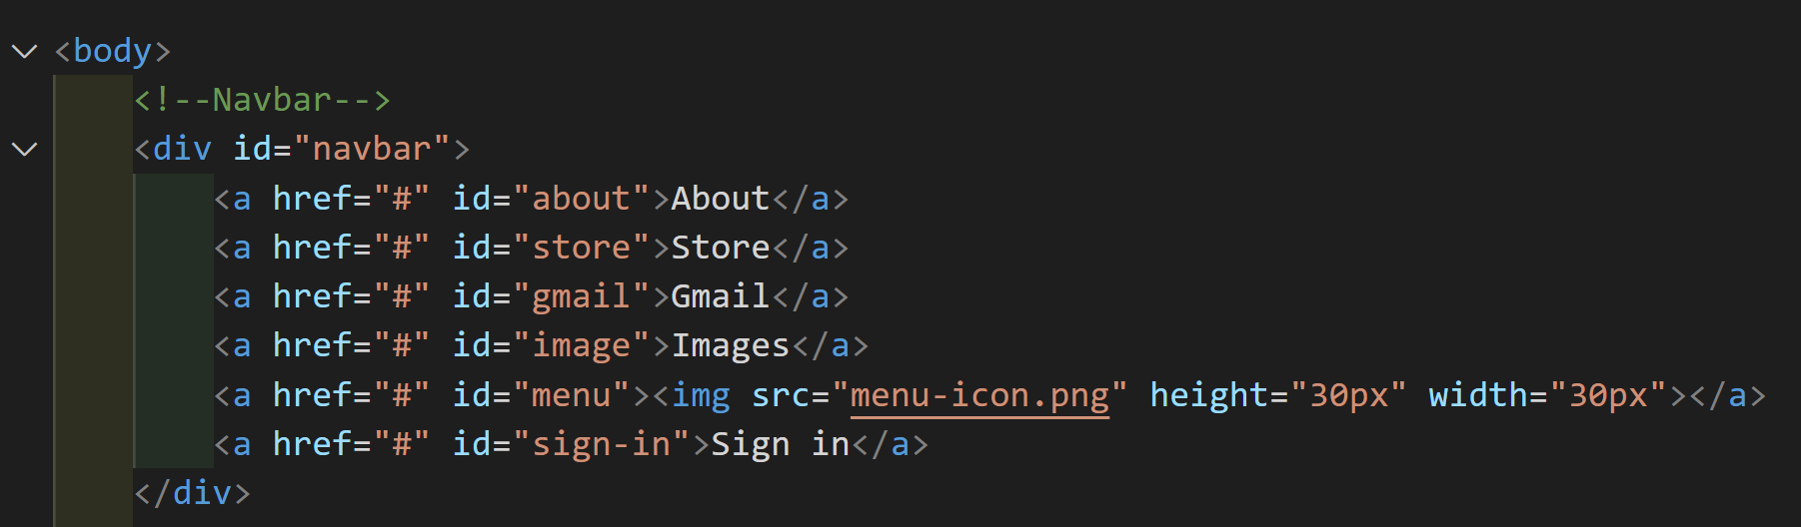
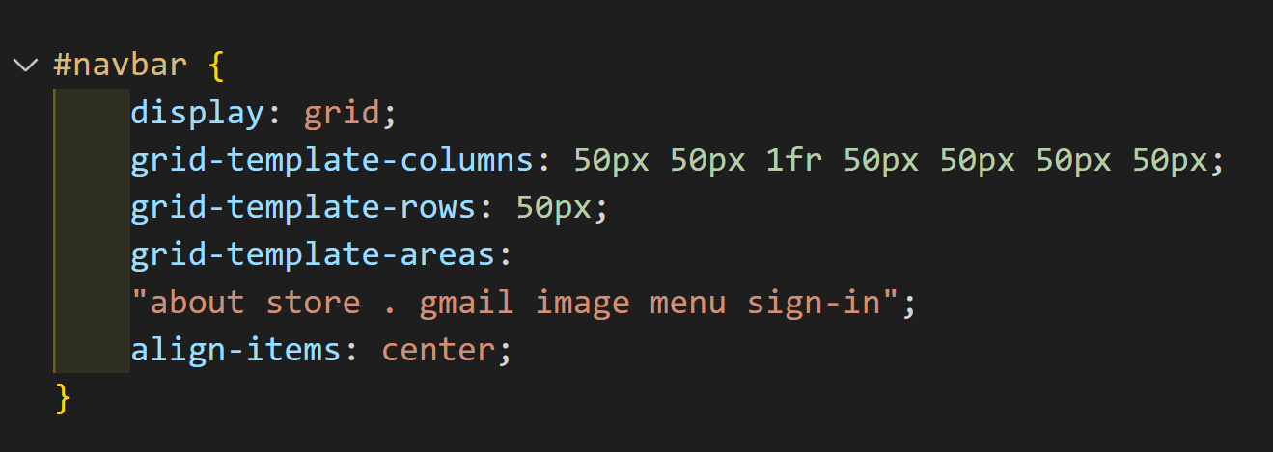
Client Side – index.html & style.css
index.html
Our nav demonstrated in our html & css files.
style.css

Slide 6
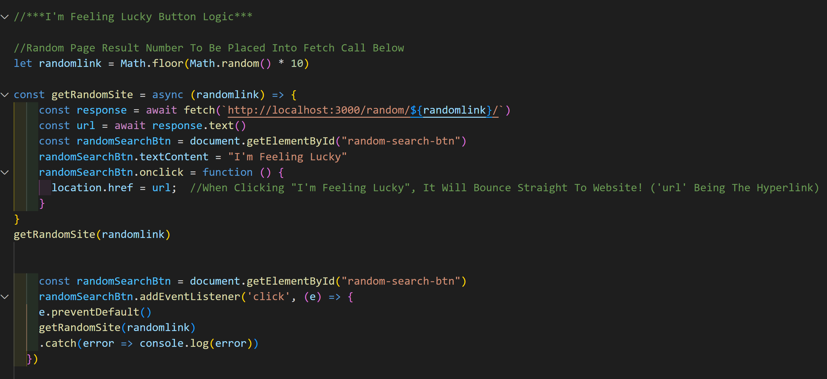
Client Side – script.js
This function demonstrates whenever we press the “I’m Feeling Lucky” button, it will randomly select the webpage from our /randomlink in our local host

Slide 7
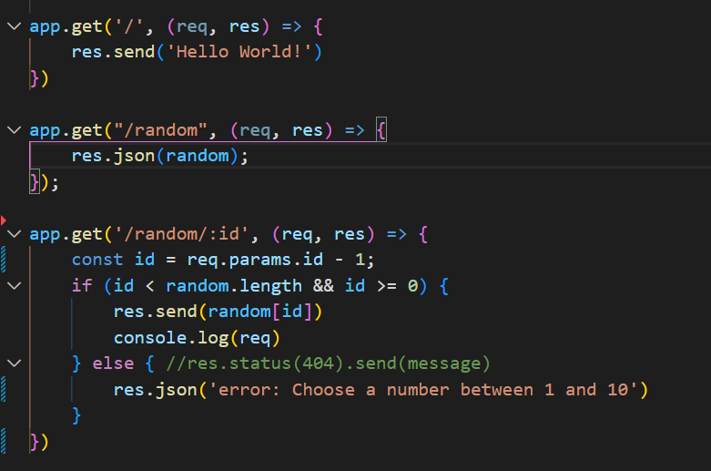
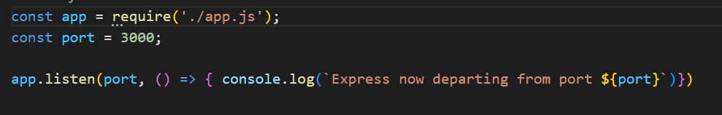
Server Side – app.js & index.js
index.js
Separated the app.js and index.js to organise our files
Index.js – have our port listening in our index.js and installing nodemon to run file
app.js – server side functionality is here
app.js

Slide 8
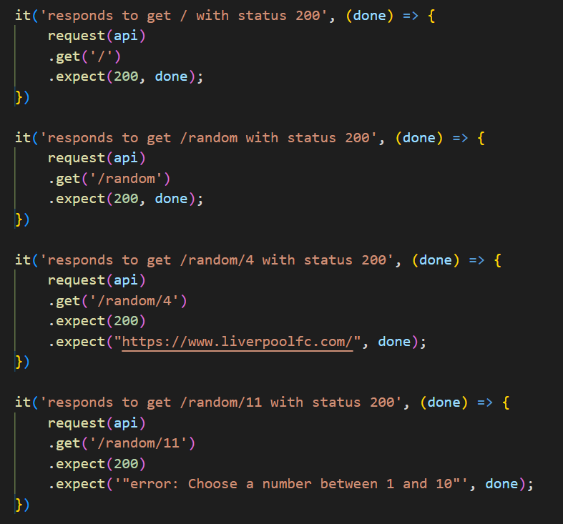
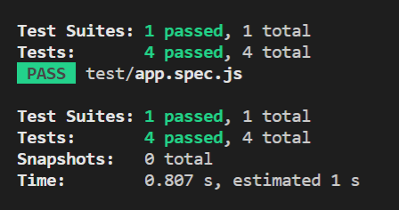
Server Side – testing
Ran four tests;
- testing the home page
- /random
- /random/4 (within our range)
- /random/11 (out of our range)
app.sepc.js

Slide 9
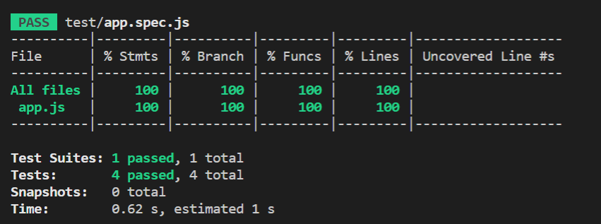
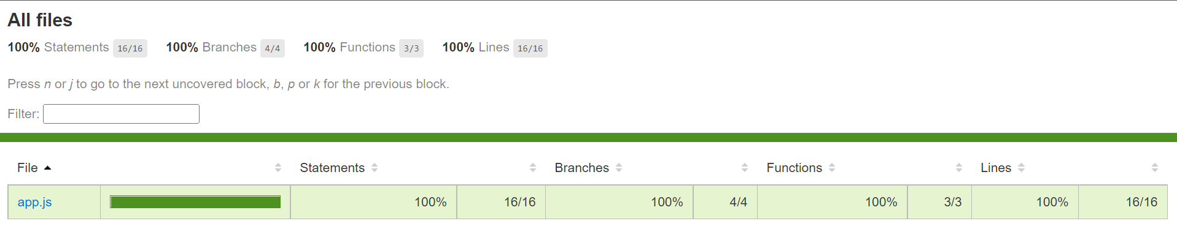
Server Side – testing (coverage)
Looked at coverage of our tests and opened within the coverage folder, the corresponding index.html that shows us within the browser

Slide 10
Retro of LAP1 Challenge – Google Clone
Wins:
Great teamwork and communication
Happy with the outcome of our project
The search engine is fully functional
Tested our app.js file and passed with 100% coverage
Challenges
Connecting the server side with the front end took some time
Adding functionality to our buttons to output the results that aimed for but through perseverance, we made it work!

Slide 11
THANK YOU

